Slide 1
Columnar Databases
Pravin Y Pawar

Slide 2
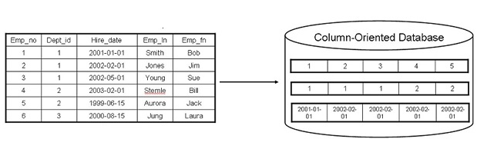
Column Oriented Databases
Column based
Partition a table by column into column families
A part of vertical partitioning where each column family is stored in its own files
Allows versioning of data values
Each storage block has data from only one column
Example,
Cassandra, Hbase

Slide 3
Columnar Databases
A database management system (DBMS) that stores data tables by column rather than by row
Compare to RDBMS -
Practical use of a column store versus a row store differs little in the relational DBMS world
Both columnar and row databases can use traditional database query languages like SQL to load data and perform queries
Both row and columnar databases can become the backbone in a system to serve data for common extract, transform, load (ETL) and data visualization tools
By storing data in columns rather than rows, the database can more precisely access the data it needs to answer a query rather than scanning and discarding unwanted data in rows
Query performance is increased for certain workloads

Slide 4
Row oriented and Column oriented data stores
A data store is basically a place for storing collections of data, such as a database, a file system or a directory
In Database system they can be stored in two ways
Row Oriented Data Stores
Column-Oriented Data Stores
Row Oriented Data Stores | Column Oriented Data Stores
Data is stored and retrieved one row at a time | Data are stored and retrieve in columns
Records are easy to read and write | Read and write operations are slower as compared to row-oriented
Best suited for online transaction system | Best suited for online analytical processing
Not efficient in performing operations applicable to the entire datasets like aggregation in row-oriented is an expensive job or operations | Efficient in performing operations applicable to the entire dataset like aggregation over many rows and columns
Typical compression mechanisms provides less efficient result | Permits high compression rates due to little distinct or unique values in columns

Slide 5
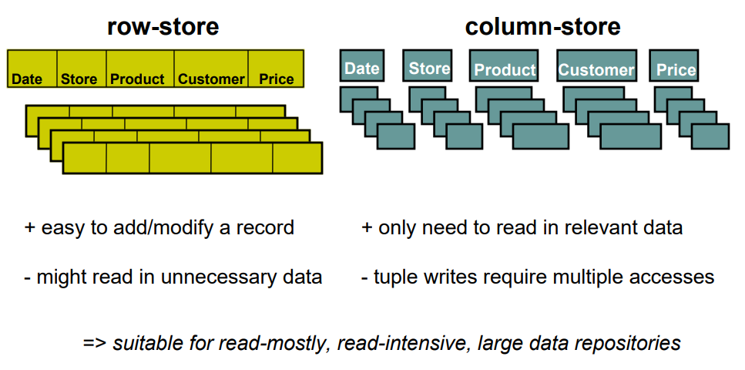
What is a column-store?

Slide 6

Apache Cassandra
An open source, column-oriented database designed to handle large amounts of data across many commodity servers
Different rows in the same table (column family) do not have to share the same set of columns
Distributed database from Apache that is highly scalable and designed to manage very large amounts of structured data
Provides high availability with no single point of failure
Developed at Facebook for inbox search
Open-sourced by Facebook in July 2008
Made an Apache top-level project since February 2010

Slide 7
Apache Cassandra (2)
Scalable, fault-tolerant, and consistent
Distribution design is based on Amazon’s Dynamo and its data model on Google’s Bigtable
Created at Facebook, it differs sharply from relational database management systems
Implements a Dynamo-style replication model with no single point of failure, but adds a more powerful “column family” data model
Used by some of the biggest companies such as
Facebook
Twitter
Cisco
Rackspace
Ebay
Twitter
Netflix

Slide 8
Features of Cassandra
Elastic scalability
Highly scalable - allows to add more hardware to accommodate more customers and more data as per requirement
Always on architecture
No single point of failure and it is continuously available for business-critical applications that cannot afford a failure
Fast linear-scale performance
Linearly scalable, i.e., it increases throughput as the number of nodes in the cluster is increased
maintains a quick response time
Flexible data storage
Accommodates all possible data formats including: structured, semi-structured, and unstructured
Dynamically accommodate changes to your data structures according to the need

Slide 9
Features of Cassandra (2)
Easy data distribution
Provides the flexibility to distribute data by replicating data across multiple data centers
Transaction support
Supports properties like Atomicity, Consistency, Isolation, and Durability (ACID)
Fast writes
Designed to run on cheap commodity hardware
Performs blazingly fast writes and can store hundreds of terabytes of data, without sacrificing the read efficiency

Slide 10
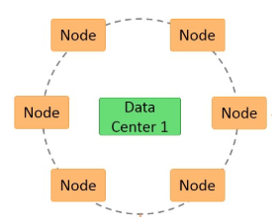
Cassandra - Architecture
Designed to handle big data
Main feature is to store data on multiple nodes with no single point of failure
Stores data on different nodes with a peer to peer distributed fashion architecture
The hardware failure can occur at any time
Any node can be down, in that case data stored in another node can be used
Nodes exchange information with each other using Gossip protocol

Slide 11
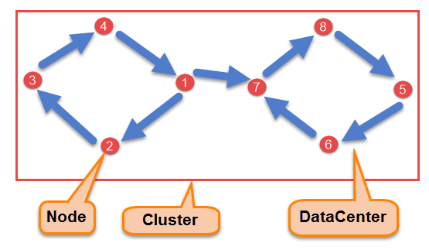
Components of Cassandra
Node
Basic component where data is stored
Data Center
A collection of nodes
Cluster
Collection of many data centers
Commit Log
Every write operation is written to Commit Log
Used for crash recovery
Mem-table
After data written in Commit log, data is written in Mem-table
Data is written in Mem-table temporarily
SSTable
When Mem-table reaches a certain threshold, data is flushed to an SSTable disk file

Slide 12
Data Replication
As hardware problem can occur or link can be down at any time during data process
data is replicated for assuring no single point of failure
Places replicas of data on different nodes based on these two factors
by the Replication Strategy - Where to place next replica is determined
by the Replication Factor - the total number of replicas placed on different nodes
For ensuring there is no single point of failure, replication factor must be three
Two kinds of replication strategies
SimpleStrategy
NetworkTopologyStrategy

Slide 13
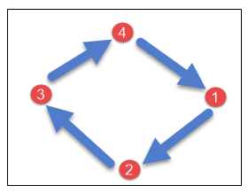
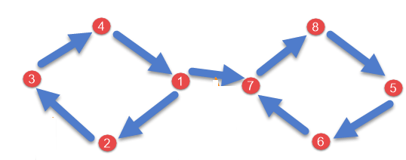
Data Replication (2)
Strategies
SimpleStrategy
is used just for one data center
Places the first replica on the node selected by the partitioner
Remaining replicas are placed in clockwise direction in the Node ring
NetworkTopologyStrategy
is used when have more than two data centers
Replicas are set for each data center separately
Places replicas in the clockwise direction in the ring
until reaches the first node in another rack
Tries to place replicas on different racks in the same
data center

Slide 14
Write Operation
The coordinator sends a write request to replicas
If all the replicas are up, they will receive write request regardless of their consistency level
Consistency level determines how many nodes will respond back with the success acknowledgment
The node will respond back with the success acknowledgment if data is written successfully to the commit log and memTable
For example
In a single data center with replication factor equals to three
Three replicas will receive write request
If consistency level is one,
only one replica will respond back with the success acknowledgment
Remaining two will remain dormant
If remaining two replicas lose data due to node downs or some other problem
Cassandra will make the row consistent by the built-in repair mechanism in Cassandra

Slide 15
Read Operation
Three types of read requests that a coordinator sends to replicas
Direct request
Digest request
Read repair request
The coordinator sends
direct request to one of the replicas
digest request to the number of replicas specified by the consistency level and checks whether the returned data is an updated data
digest request to all the remaining replicas
If any node gives out of date value, a background read repair request will update that data

Slide 16
Thank You!
In our next session: Graph Databases

